Slide 1
Introduction to Cryptography

Slide 2
Field of Cryptology

Slide 3
Cryptography is the practice and study of techniques for secure communication in the presence of third parties called adversaries.
Greek roots kryptos, meaning "hidden,"
graphein, meaning "to write.“
Cipher
an algorithm for performing encryption or decryption
Cryptanalysis
the art or process of deciphering coded messages without being told the key
Cryptology
Cryptography
Symmetric Ciphers
Asymmetric Ciphers
Cryptanalysis
Protocols
Early signs of encryption in Eqypt in ca. 2000 B.C. Letter-based encryption schemes (e.g., Caesar cipher) popular ever since.
Before 1976
1976
hybrid schemes

Slide 4
Symmetric Cryptography Example
secret-key

Slide 5
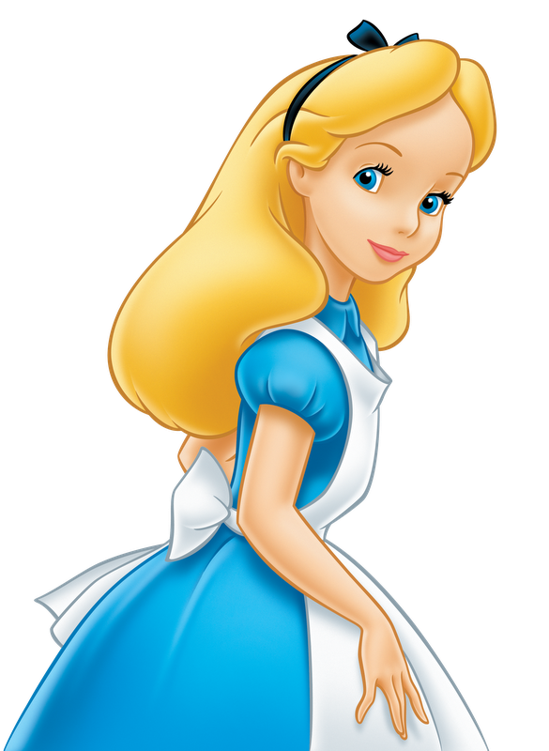

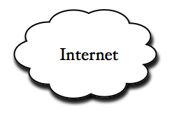
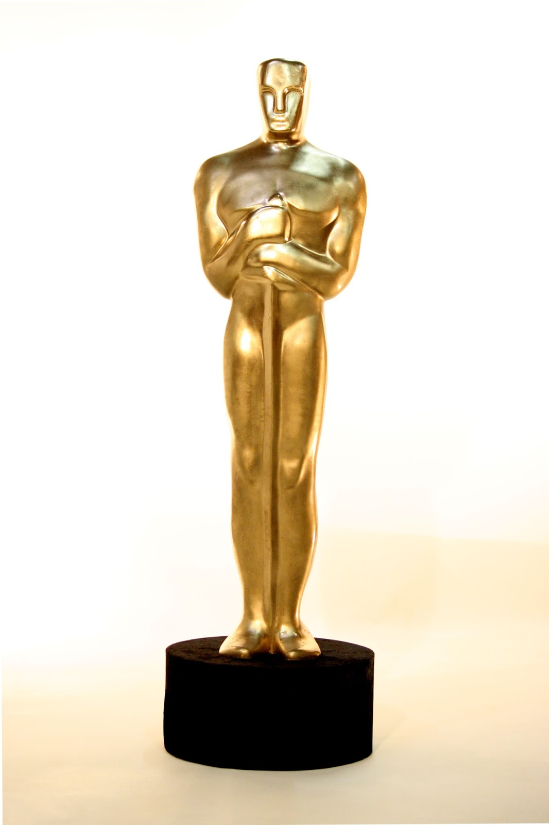
Problem of Internet: The Internet is Inherently Insecure
By design, the Internet is an open network which facilitates the flow of information between computers.
Security of not the main goal of design
Technologies are available so the Internet may be used for secure electronic commerce transactions, but failure to review and address the inherent risk factors increases the likelihood of system or data compromise.
Data Confidentiality, Data Integrity, Authentication
Unsecure
Bad guy

Slide 6
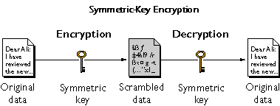

https://www.ibm.com/support/knowledgecenter/en/SSB23S_1.1.0.14/gtps7/s7symm.html

Slide 7
x=plaintext
K
y=ciphertext
K
key space = Set of all keys {K1, K2, ...,Kn}
https://www.ibm.com/support/knowledgecenter/en/SSB23S_1.1.0.14/gtps7/s7symm.html

Slide 8
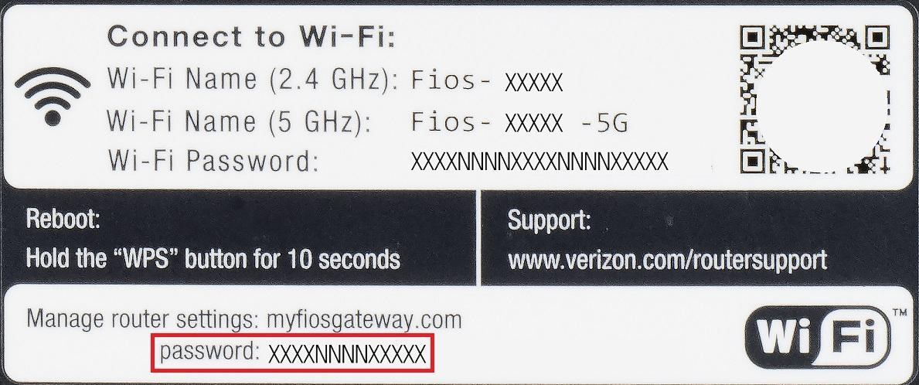
Math Formula for symmetric cryptography
Encryption equation y = e (x, k)
Decryption equation x = d (y, k)
The key transmission
Must via a secure channel between Alice and Bob.
Methods
Manually installing the key for the Wi-Fi Protected Access (WPA) protocol
Post office for credit cards

Slide 9
The idea of secure communication
The system is only secure if an attacker does not learn the key K
even if the attacker knows all details about the system , the attacker can’t know plaintext (Kerckhoff‘s Principle )
The problem of secure communication is reduced to secure transmission the key K

Slide 10
Cryptanalysis

Slide 11
Motivation: Why do we need Cryptanalysis
There is no mathematical proof of security for any practical cipher
The only way to have assurance that a cipher is secure is to try to break it (and fail) !

Slide 12
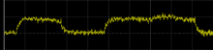
Social Engineering: E.g., trick a user into giving up her password
Cryptanalysis
Classical Cryptanalysis
Mathematical Analysis
Brute-Force Attack
implementation Attack
Social Engineering
Power consumption
Timing
With/without multiplication

Slide 13
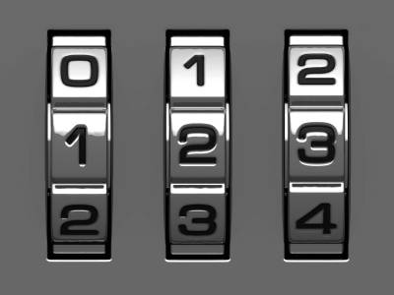
Brute-Force Attack
Repetitive successive attempts of trying various keys (password) combinations to break into any systems
How many keys to we need ?
10*10*10=1000

Slide 14
Key space and key length
Key length (size) in bits
Key space
10*10*10=1000= 2 ¹⁰
x=0 or 1
=
x | x | x | x | x | x | x | x | x | x

Slide 15
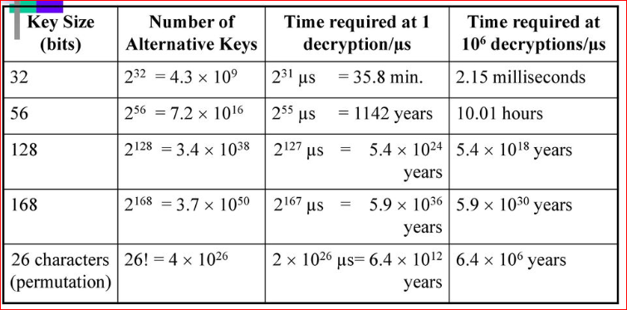
Key strength
https://slideplayer.com/slide/12031562/69/images/53/Average+time+required+for+exhaustive+key+search.jpg

Slide 16
Lab: Generate password

Slide 17
Question 1?
We want to guess the code (key) for a lock.
How many keys do we have to try?
How to generate a wordlist (contains all possible keys) for password cracking. Let's assume that we know the lock has passwords with 3 digits.

Slide 18
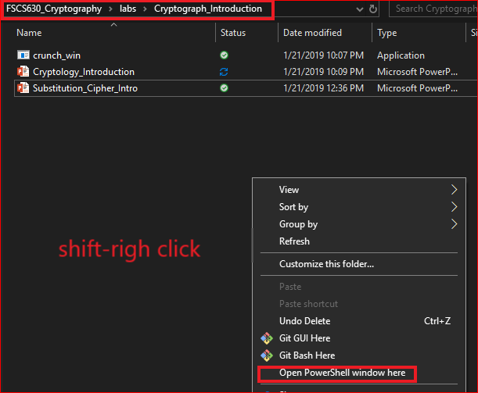
Use Windows command

Slide 19
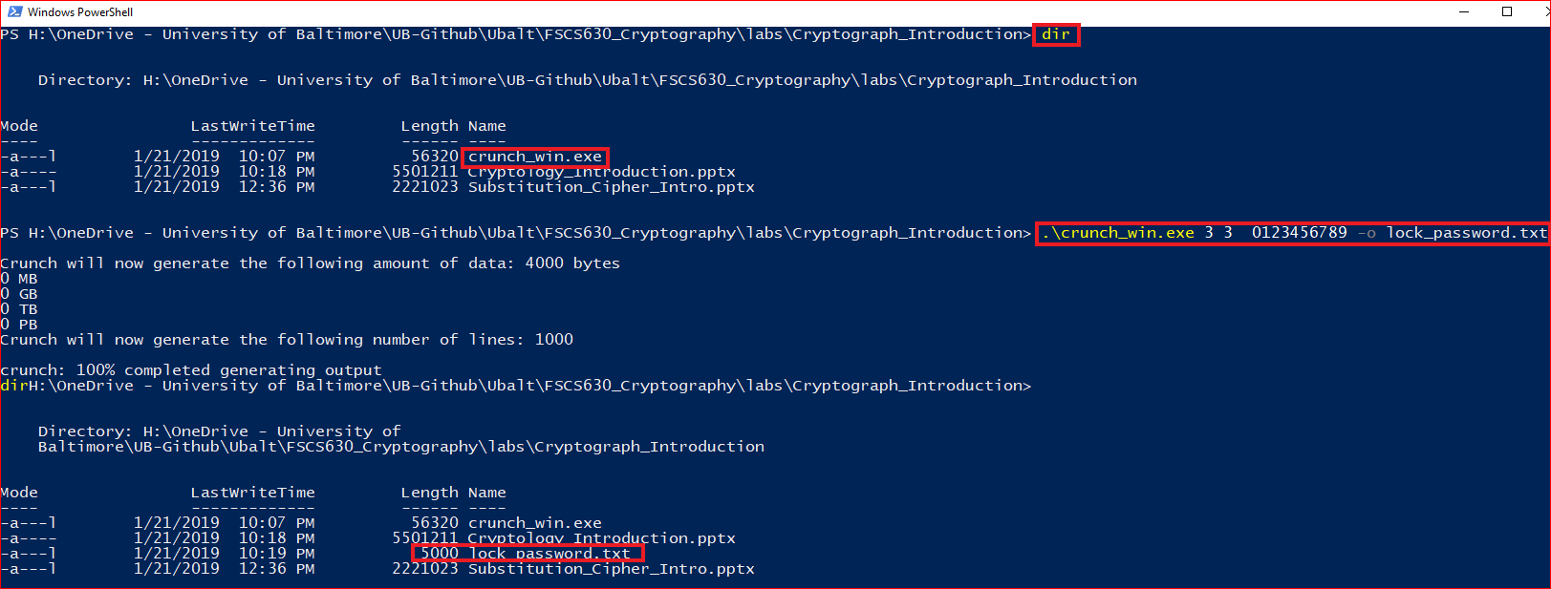
Generate password

Slide 20
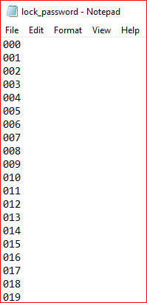
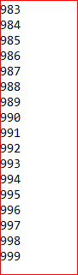
List generated password

Slide 21
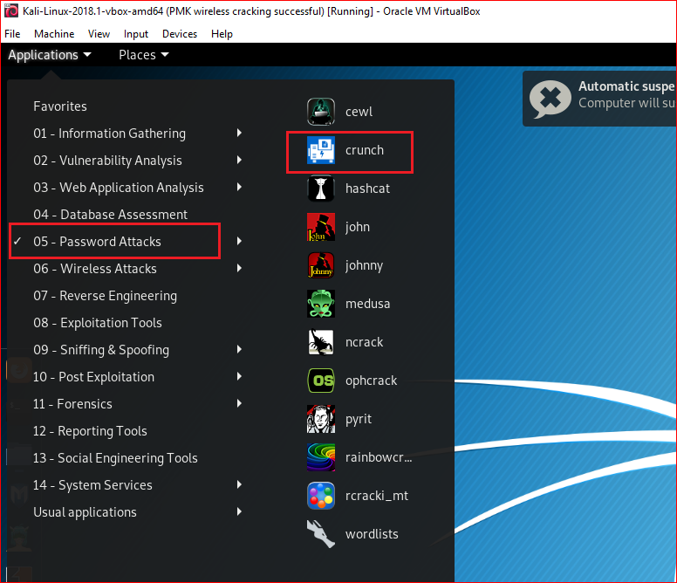
Use Linux

Slide 22
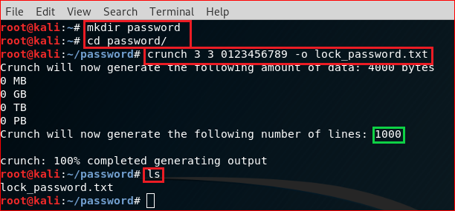
crunch <min-len> <max-len> [<characterset>] [-o outputfile]
Min-len = The minimum password length.
Max-len = The maximum password length.
characterset = The character set to be used in generating the passwords.
-o outputfile = This is the file you want your wordlist written to.

Slide 23
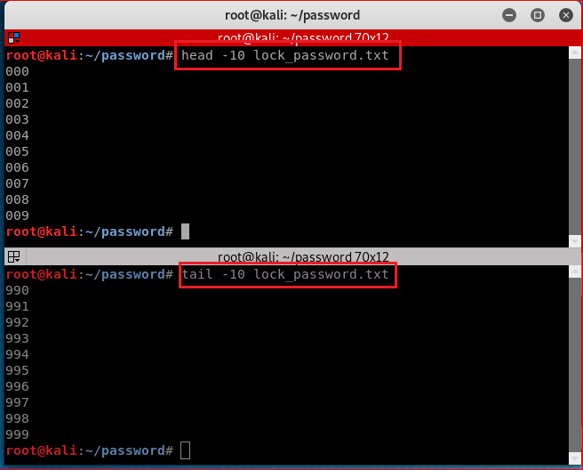

Slide 24
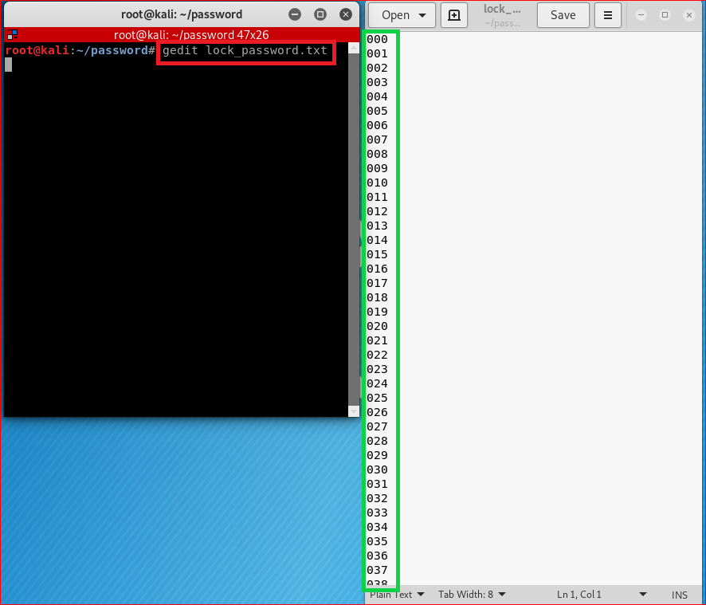
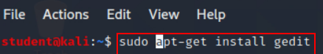
Or you can use leafpad command

Slide 25
Question 2
Let's assume that we know one has an email password is 4 characters.
characters: 26 low case letters a-z
How many possible keys?
Key space
26*26*26*26=456,976

Slide 26
Question 2
We can generate all the possibilities in crunch by typing crunch 4 4 -o wordlist4_8.txt

Slide 27
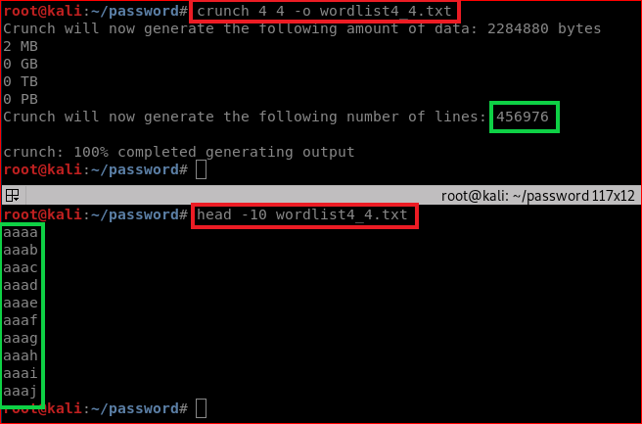

Slide 28
Question 3
If we knew that the target's birthday was July 12 and they likely used that date at the end of a eight-character password.
We could generate all the possibilities of eight-character passwords that end with 0712
You name the file as birthdaywordlist.txt
abcd0712

Slide 29
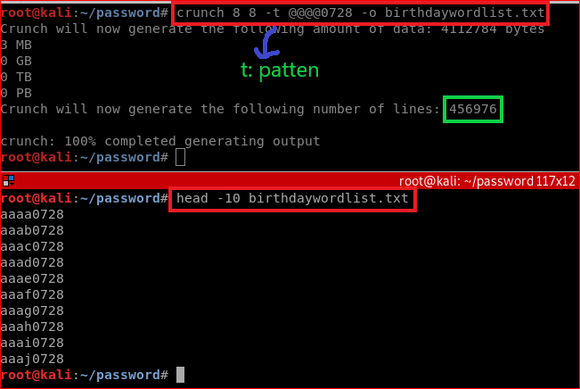
@ will insert lower case characters
* will insert upper case characters
% will insert numbers
^ will insert symbols

Slide 30
Question 4
If we knew that your neighbor’s wifi password has the following patterns
Less than and equal to 10 characters
Start with his first name with lower case: frank
End with his birthday
You task is to generate all the possibilities passwords
You can name the file as wifiwordlist.txt, e.g., frank0712
How many passwords?
Notes:
9 9 -t frank%%%% -o wifiwordlist.txt
10 10 -t frank@%%%% -o wifiwordlist.txt

Slide 31
References
https://github.com/shadwork/Windows-Crunch/releases

